Slide 1

Think about it
Linux OS –‣ Basics
Command Line Basics –‣ Basics
SSH –‣ ssh access, keys, key copy
HPC Clusters –‣ Overview
MPI Basics –‣ Overview
Notes:
30

Slide 2

Provides abstraction between hardware and software
Provides access to the system for the user
Performs a number of task
Disk space management, device drivers management
memory management, swap memory
Process scheduling, file access, computations
Security, activity logging, access management
Notes:
30
30

Slide 3

Windows
Mac OSX
Linux
UNIX
CP/M
OS2
BeOS
VMS
Notes:
30
30

Slide 4




AT&T (1960s)
Linux Kernel
(1991)
Berkeley Standard Distribution (BSD)
System V
FreeBSD
Solaris
OpenBSD
HP-UX
NetBSD
AIX
Family Tree
Notes:
30
30

Slide 5

UNIX/Linux
Many free, open source options
Performance, reliability
Customizability, ease of development
Free software
Windows
Devices typically “just work”
Availability of commercial applications
Notes:
30
30

Slide 6
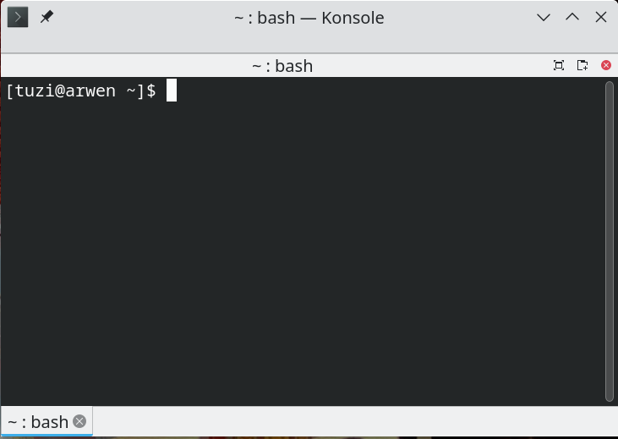
Command Summary
Command Line Basics –‣ Basics
Open a shell – (terminal, concole, konsole, cmd,powershell)
Notes:
30

Slide 7
Command Summary
Command Line Basics –‣ Basics
Envitonment variables (env)
.bashrc OR .bash_aliases
Notes:
30

Slide 8
System Structure
Directory Tree -
dev – contains the special device files for all the – devices (character & block, socket, pipe)
– virtual files, not physically on the disk
– files that represent devices
file type is one of the following characters:
b block special file c character special file
C high performance ("contiguous data") file
d directory D door (Solaris 2.5 and up)
l symbolic link M off-line ("migrated") file (Cray DMF)
n network special file (HP-UX)
p FIFO (named pipe) P port (Solaris 10 and up)
s socket

Slide 9
System Structure
Directory Tree -
cat +
/proc/cpuinfo – CPU Information
/proc/filesystems – It keeps the useful info about the processes that are running currently.
/proc/interrupts – Shows information about the # of interrupts per IRQ.
/proc/ioports – Shows I/O addresses used by devices on the server.
/proc/meminfo – Shows the memory usage information.
/proc/modules – Shows using kernel module.
/proc/mounts – Shows mounted File-system Information.
/proc/stat – displays the detailed statistics of the current system.
/proc/swaps – contains swap file information.

Slide 10
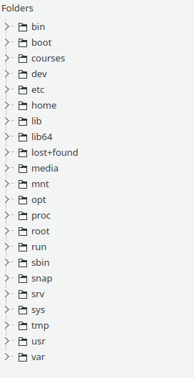
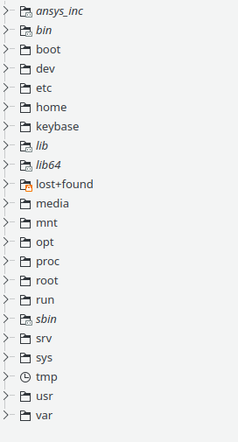
Fedora
System Structure
Ubuntu
Directory Tree -
dev & proc

Slide 11
Command Summary
Basic Commands
File Exploration: tail head less more
Navigation: <TAB> up & down (History) ls dir mkdir rmdir cd cp mv rm touch
Info Tools top lsusb lsmem lspci lsmod lscpu hostnamectl loginctl journalctl
Search: grep who top
Search Filters: wc sort uniq cut tr
Process Control ps aux top kill killall CTRL + C CTRL + Z
Editors: nano vi vim
Admin: passwd chmod chown chgrp sudo su who w whoami
Redirects
> >> 1 2 | echo
2>&1 ? send all output to dev/null and NOT to a log file
Notes:
30

Slide 12
Command Summary
Basic Commands
ls, ls -l, ll, dir, dir -l – list files
mkdir (name) – make a directory (folder)
rmdir (name) – remove a directory
cd (location) – move to a directory cd /home cd ../ cd /
cp (source) (destination) – copy files
mv (S) (D) – move files
rm (files) – remove files
touch (name) – create a text file
Notes:
30

Slide 13
Command Summary
Basic Commands
CTRL + C – kill a process
CTRL + Z – suspend a process
<TAB> – command completion
up & down – (History)
tail – see the tail end of a file e.g tail data.txt
head – see the head end of a file e.g head -n 50 data.txt
less – view/navigate the content of a file e.g less data.txt
more – view the content of a file e.g more .txt ls | more
Notes:
30

Slide 14
Command Summary
Basic Commands
who, w – who is on the system
whoami -isn’t it obvious?
Notes:
30

Slide 15
Command Summary
Basic Commands
passwd – change your password
chmod – change permissions on a file e.g chmod 777 file.txt
chown – change ownership of a file e.g chown ftuzi:ftuzi file.txt
chgrp – change group membership
sudo (command) – temporarily run a command as root
su – switch user e.g su (become root) su ftuzi (become ftuzi)
Notes:
30

Slide 16
Find
find <top search location> <options> <search string>
find . -name "*.jpg" find / -name "*.jpg"
find . -user daniel find . -type d -name "b*"
find /etc/ -user root -mtime 1
find ./foo -name "*.bak" -delete
find ~ -perm 777 find ~ -size +10M
Find / -size -10M find /var/ -size 10M
find ./ -type f -exec sed -i 's/find/replace/g' {} \;
Notes:
30

Slide 17
SSH
Think about it
SSH –‣ ssh access, keys, key copy
SSH folder - cd .ssh
authorized_keys
known_hosts
id_rsa
id_rsa.pub
Notes:
30

Slide 18
SSH Keys
From the command line
Ssh-keygen -t algorithm (rsa, dsa, ecdsa, ed25519) -b size
e.g. ssh-keygen -t rsa -b 4096 ssh-keygen -t dsa
ssh-keygen -t ecdsa -b 521 ssh-keygen -t ed25519
Ssh-copy-id - Copy public key to accessing server
ssh-copy-id -i ~/.ssh/tatu-key-ecdsa user@host
Notes:
30

Slide 19
SSH Related Commands
ssh
ssh-agent store private keys for public authentication
ssh-copy-id copy to remote
ssh-keyscan scan public keys
ssh-keygen create public keys
ssh-add
sshare
sshd ssh server
sshfs mount remote file systems locally via ssh
Notes:
30

Slide 20
HPC Hardware & Usage
HPC Clusters –‣ Overview
Excellent overview of HPC
https://hpc.llnl.gov/documentation/tutorials/introduction-parallel-computing-tutorial
Notes:
30

Slide 21
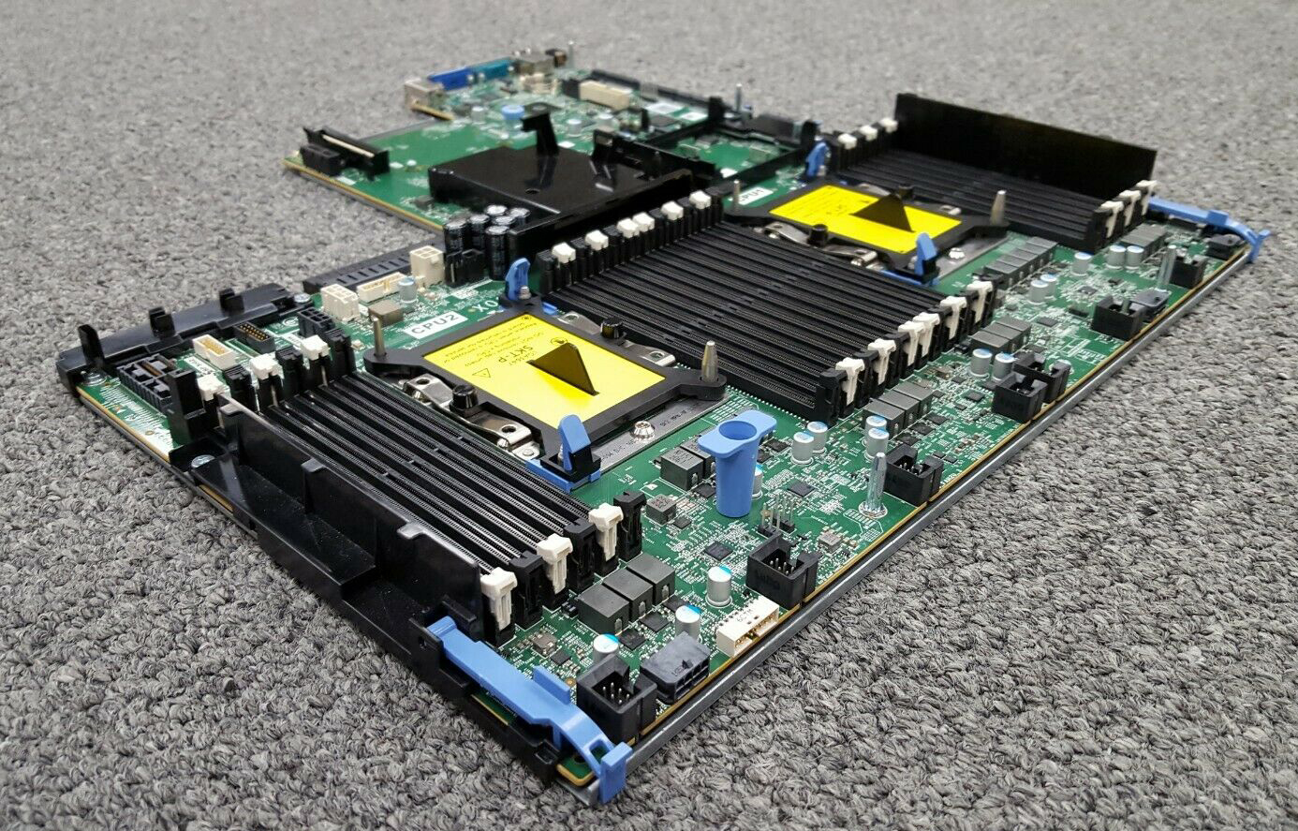
ENGR 245 Introduction to High Performance Computing
Hardware
PowerEdge R740XD Server
Up to 24 HD/SSD/NVMe Drives
Up 3 CPU We have 2
192 GB RAM
3 – 1.2 T HD
2 Power supplies

Slide 22

ENGR 245 Introduction to High Performance Computing
Hardware

Slide 23
Hig Performance Computers
Login Node
Ethernet to Internet
Ethernet to HPC
Head Node
switch
Compute
Node
Compute
Node
Compute
Node
Compute
Node
Compute
Node
Compute
Node
Compute
Node
Compute
Node
Compute
Node
Compute
Node
Compute
Node
Compute
Node

Slide 24
HPC Hardware & Usage
HPC Clusters Issues & Problems
Bottlenecks - Physical & Communications
https://hpc.llnl.gov/documentation/tutorials/introduction-parallel-computing-tutorial
Notes:
<number>

Slide 25

MPI
MPI in HPC
Message Passing Interface

Slide 26
MPI in HPC
Parallel programming requires message passing between processes.
Single Program Multiple Data
MPI is a set of compiler directives that a non-OpenMP-capable compiler would just regard as comments and ignored

Slide 27

Features
User writes a single code that will run on all cluster nodes
Data stored on each node is entirely separate from that on other nodes
In order to get data from other nodes, you MUST explicitly call the appropriate library where the information is stored
Allows master to break tasks between slave nodes
Notes:
A remarkable feature of MPI is that the user writes a single code which runs on all the computers. However, because each computer is assigned a unique identifying number, it is possible for different actions to occur on different machines, even though they run the same code

Slide 28
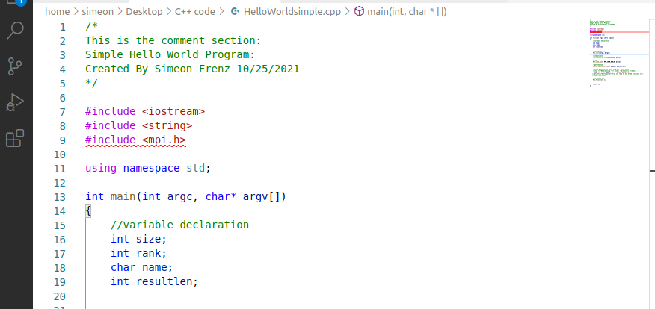
MPI in HPC
A statndard C++ program

Slide 29
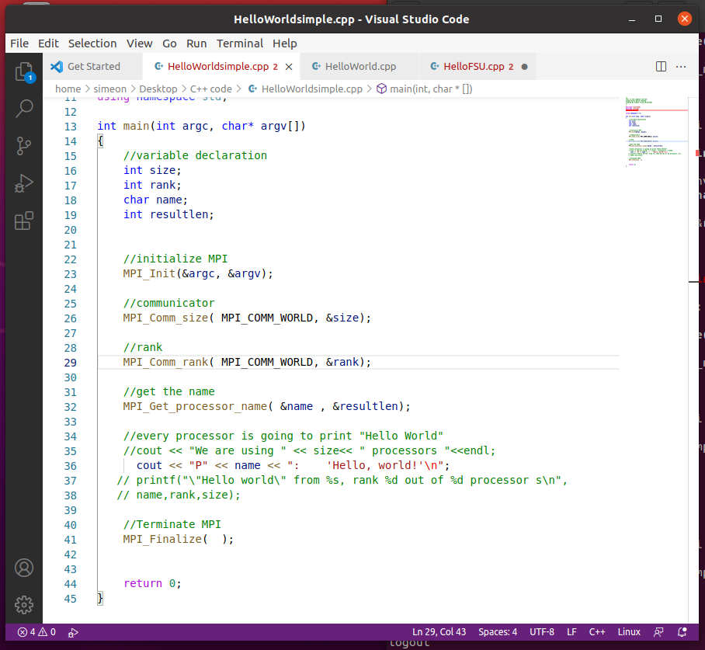
MPI in HPC
A statndard C++ program
That include MPI directives

Slide 30

MPI Commands
Nano, VS Code
Creates and opens file editor. Also used to just edit existing file.
Mpicxx
C++ MPI compiler
Mpicxx –o
Creates executable file for C++ program
Mpirun
Executes the executable file

